Slide 1
CAPSTONE PROJECT 1
Monthly Product Sales Visualization
Presented By:
Student Name- SNEHANSHU RAJ
College Name- IIT PATNA
Department- BSc (Hons.) COMPUTER SCIENCE AND DATA ANALYTICS
Email ID – snehanshu_2312res647@iitp.ac.in

Slide 2
Outline
Problem Statement
System Development Approach (Technology & methodology)
Algorithm & Deployment
Result
Conclusion
Future Scope (Optional)
References

Slide 3
Problem Statement
The aim of this project is to analyze total revenue generated across different regions and payment methods for a given dataset. The primary objective is to:
Identify which region and which payment methods contribute most to total revenue.
Provide insights that can help stakeholders optimize business strategies.
Discover patterns and anomalies by performing exploratory data analysis (EDA).
This analysis will help both management and business analysts to take data-driven decisions to maximize revenue.

Slide 4
System Approach
System Requirements:
Any platform supporting Jupyter Notebooks (Windows, Mac, Linux)
Python 3.x
Libraries Required:
Pandas: For data manipulation and analysis
Matplotlib: For data visualization

Slide 5
Algorithm & Deployment
Data Collection: Load the sales and revenue data, most likely from a CSV/Excel file.
Data Cleaning: Inspect the data for missing or inconsistent values and clean as necessary.
EDA – Revenue by Region: Group data by Region and calculate the sum of revenue.
EDA – Revenue by Payment Method: Group data by payment methods and calculate total revenue.
Visualization:
Bar: top 10 products sold
Line: Monthly revenue trend
Pie: Product category contribution
Donut: sales revenue contribution by region
Reporting: Document findings, create summary tables, and prepare visual illustrations.
Deployment: Results and notebook shared via GitHub for reproducibility.

Slide 6
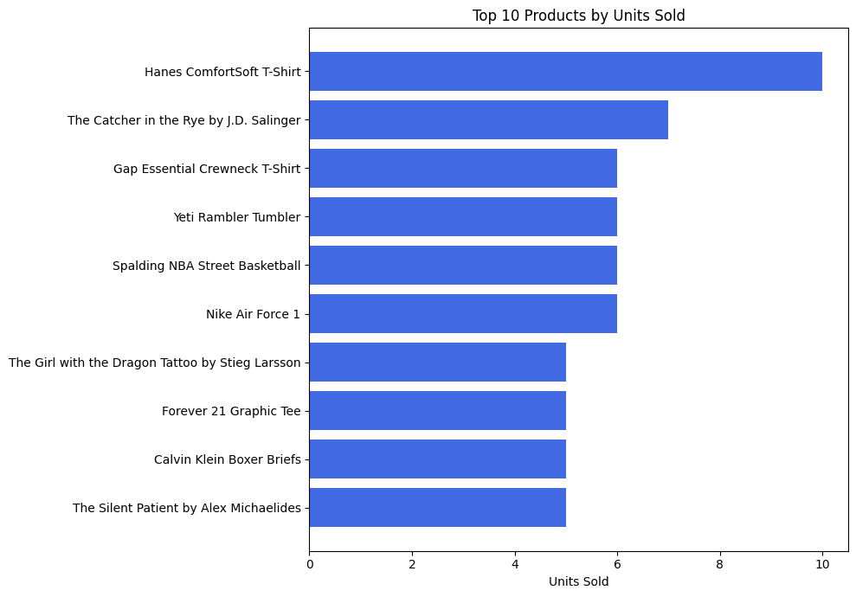
Bar plot for top 10 products sold

Slide 7
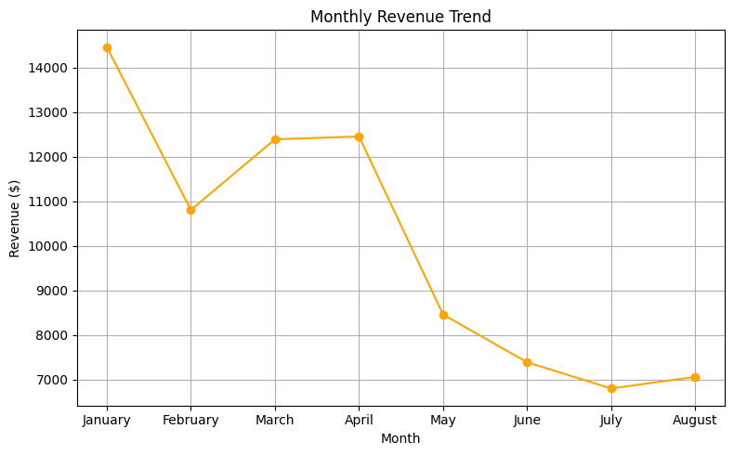
Line graph representing monthly revenue trend

Slide 8
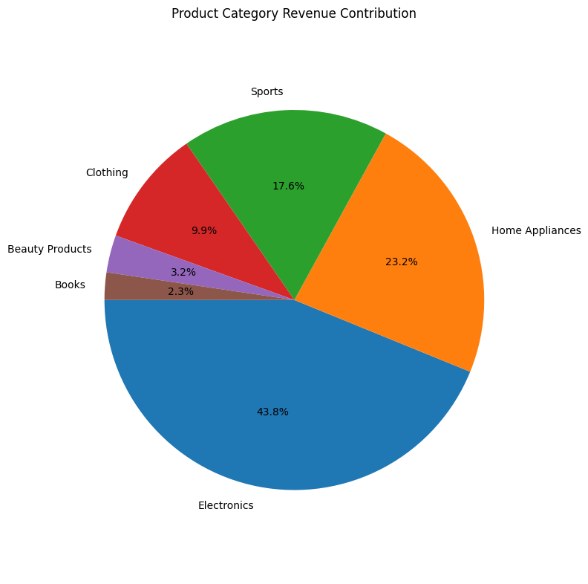
Pie chart representing product category revenue contribution

Slide 9
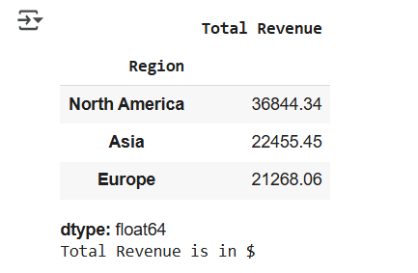
Region and sum revenue
Region | Total Revenue
North America | 36844.34
Asia | 22455.45
Europe | 21268.06

Slide 10
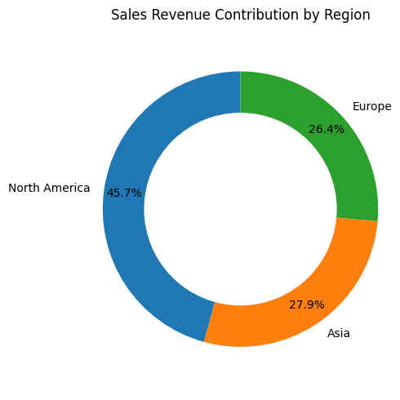
Donut chart representing sales revenue contribution by region

Slide 11
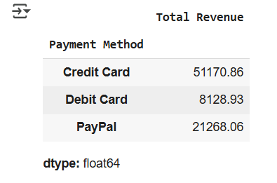
Payment method and revenue
Payment Method | Total Revenue
Credit Card | 51170.86
Debit Card | 8128.93
PayPal | 21268.06

Slide 12
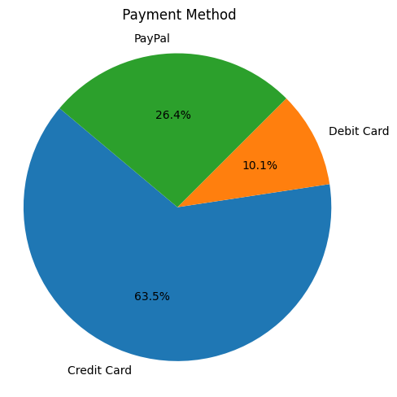
Pie chart representing payment methods

Slide 13
Conclusion
The analysis identified that North America had the highest total revenue.
Credit Card was the most popular payment method contributing to total revenue.
The EDA approach allowed for easy identification of business hotspots and potential areas for improvement.
Challenges: Data cleaning and ensuring accuracy during group by operations.
Possible improvements: Incorporate time trends, deeper statistical analysis, or predictive modeling.

Slide 14
Future Scope
Extend the analysis to include time-series forecasting on revenues.
Drill down further to customer segment or product category.
Deploy interactive dashboards for real-time business monitoring.

Slide 15
References
Pandas documentation
Matplotlib documentation
Kaggle for dataset

